Slide 1

SMART INDIA HACKATHON 2026
Problem Statement ID – SIH26106
Problem Statement Title - AI-Powered Email Threat Detection, GeoLocation and Forensic Intelligence Platform
Theme- Blockchain & Cybersecurity
PS Category- Software
Team ID-
Team Name (Registered on portal)-Web Innovators

Slide 2
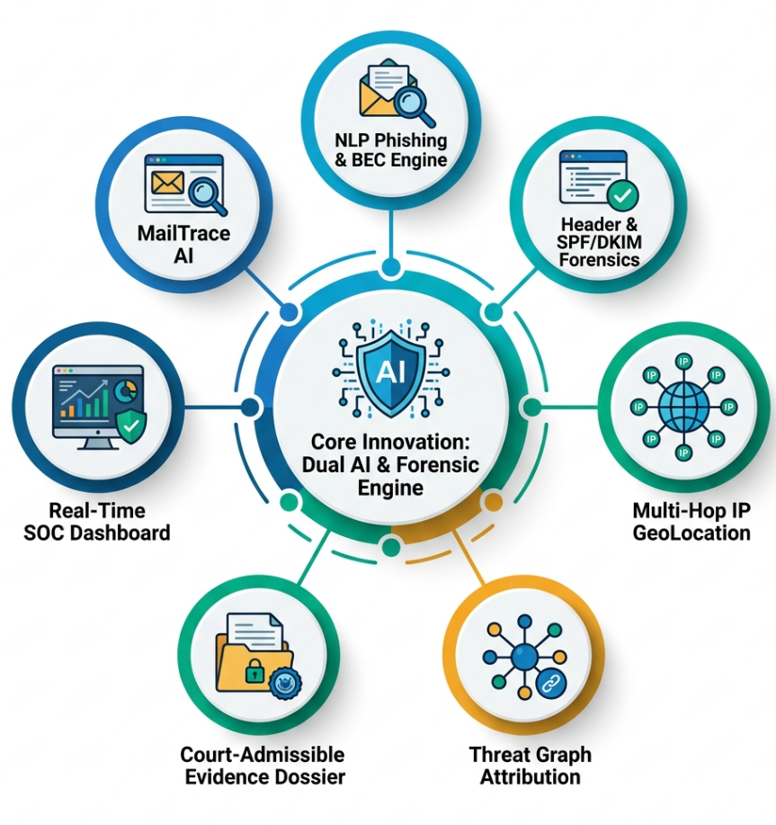
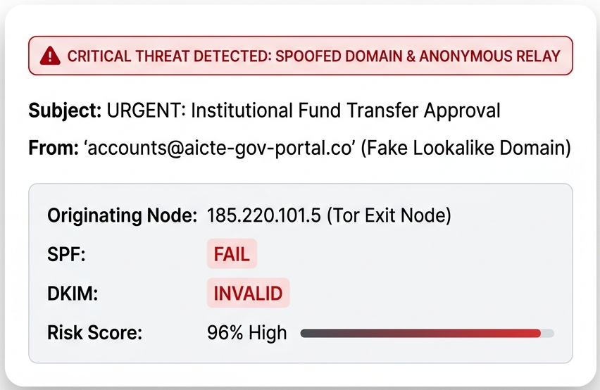
MailTrace AI : AI-Powered Email Threat Detection, Geolocation & Forensic Intelligence
Web Innovators
Real-world issue : Over 91% of cyberattacks start via email (BEC, Spear-Phishing, CEO Fraud). Attackers use AI-generated language, spoofed domains, and multi-hop relay chains to bypass traditional spam filters.
RISK
SOLUTION
Sophisticated BEC & Spoofing
AI Semantic & Header Alignment Check
Anonymized Relays & VPNs
Earliest Node Extraction & IP Geolocation
Lack of Legal / FIR Evidence
ISO/IEC 27037 Tamper-Proof Forensic PDF
Why important : India loses ₹1.25+ Lakh Crores annually to cyber fraud; educational & government institutions (AICTE, universities) are prime targets. Existing filters only block emails but fail to trace origin infrastructure for police/legal action.--
Solution : MailTrace AI combines NLP transformers, RFC-header forensic parsing, multi-hop IP geolocation, and graph attribution to detect threats in real time and trace their origin.

Slide 3
TECHNICAL APPROACH
Web Innovators
INPUT
Methodology & Process
Email Upload • Headers • Body + URLs
Project Components & Technologies
CRYPTOGRAPHIC SPF/DKIM AUDIT
PART
Technology
Validate & present security proofs
AI PROCESSSING
RAW INGESTION & RFC PARSING
CRYPTOGRAPHIC SPF/DKIM AUDIT
EMAIL SECURITY LIFECYCLE
Validate detection of malicious activity
NLP Engine
Backend
Python + FastAPI
Raw data processing and parsing
• Phishing detection • Classify email
• SPF/DKIM • IP → Location • ipinfo.io
Frontend
React + Vite
FORENSIC DESIRED EXPORT
METHODOLOGY
AI / NLP DECEPTION ANALYSIS
Database
• scikit-learn
SQLite / MySQL
Final reporting to train, assess & act
Machine learning & NLP analysis
THREAT GRAPH CORRELATION
Email Analysis
Python libraries
Pattern recognition & network correlation
DATABASE
ML/AI
scikit-learn + pre-trained models
• Email Cases • Analysis Logs • Evidence
IP Geolocation
Ipinfo.io FREE API
MySQL
Leaflet.js
MAP
OUTPUT
REPORTS
ReportLab(pdf)
• Fraud Score • Geo Map • PDF Report
React.js

Slide 4
FEASIBILITY,RISKS&MITIGATION STRATEGIES
Web Innovators
1
2
3
POTENTIAL RISKS & CHALLENGES
MITIGATION STRATEGIES
FEASIBILITY PILLARS
Zero-Hardware Deployment
⚠️
VPN & Tor Cloaking
✓
Multi-Hop RFC Node Trace
⚙
↗
Scalable Microservices
Privacy & PII Leakage
✓
AES-256 PII Redaction & BSA Compliance
🔐
$
Cost-Effective Open Stack
⚠️
False Positives at Scale
!
✓
Confidence-Based AI Triage

Slide 5
IMPACT AND BENEFITS :TRANSFORMING CYBER DEFENCE
Web Innovators
SECURITY IMPACT
USER IMPACT
• Detect phishing, spoofing and suspicious email patterns
• Flag malicious links and attachments
• Provide risk-based alerts before user interaction
• Strengthen the first layer of email defense
• Simple warnings for non-technical users
• Explain why an email is risky
• Reduce accidental clicks and unsafe downloads
• Build practical cybersecurity awareness
ECONOMIC BENEFITS
SOCIAL BENEFITS
• Reduce potential fraud and financial losses
• Lower cost of handling security incidents
• Minimize downtime and recovery effort
• Scalable for organizations and institutions
• Safer digital communication
• Better protection for students and employees
• Encourage responsible online behavior
• Increase trust in digital communication

Slide 6
RESEARCH AND REFERENCES
Web Innovators
Do et al. — Deep Learning for Phishing Detection: Taxonomy, Challenges & Future Directions, IEEE Access, 2022 — doi.org/10.1109/ACCESS.2022.3151903
Sahingoz et al. — DEPHIDES: Deep Learning Based Phishing Detection System, IEEE Access, 2024 — doi.org/10.1109/ACCESS.2024.3352629
Altwaijry et al. — Advancing Phishing Email Detection: A Comparative Study of DL Models, Sensors, 2024 — doi.org/10.3390/s24072077
Wang & Wang — Revisiting Email Forwarding Security under the ARC Protocol, ACM WWW, 2022 — doi.org/10.1145/3485447.3512228
Iyer et al. — Email Spoofing Detection Using Volatile Memory Forensics, IEEE CNS, 2017 — semanticscholar.org
Phishing Email Dataset (Enron + Nazario + CEAS + Nigerian + SpamAssassin) — kaggle.com/datasets/naserabdullahalam
MaxMind GeoLite2 — free IP geolocation database — dev.maxmind.com/geoip
AbuseIPDB — IP reputation & abuse reporting — abuseipdb.com
OTX (AlienVault) — open threat intelligence feeds — otx.alienvault.com
RFC 7208 (SPF), RFC 6376 (DKIM), RFC 7489 (DMARC) — rfc-editor.org
CERT-In — national cyber incident reporting guidelines — cert-in.org.in
Digital Personal Data Protection Act, 2023 (MeitY) — meity.gov.in
Feature | Ours | Spam Filters | Header/GeoIP Tools | Enterprise Suites
NLP / BEC Content Detection | ✅ | ⚠️basic | ❌ | ✅
Header & Protocol Forensics | ✅ | ❌ | ⚠️view-only | ✅
IP Geolocation & Infra Mapping | ✅ | ❌ | ⚠️standalone | ⚠️Partial
Campaign / Graph Correlation | ✅ | ❌ | ❌ | ⚠️Limited
Forensic Report + Chain-of-Custody | ✅ | ❌ | ❌ | ⚠️Partial
Open-Source, Institution-Friendly Cost | ✅ | ✅ | ✅ | ❌

